Slide 1

Kit-for-kids: Build a Camera Kit

Slide 2
Overview
~5-10 min introduction from Tom
~40 min group activity brainstorming what our kit-for-kids will look like

Slide 3
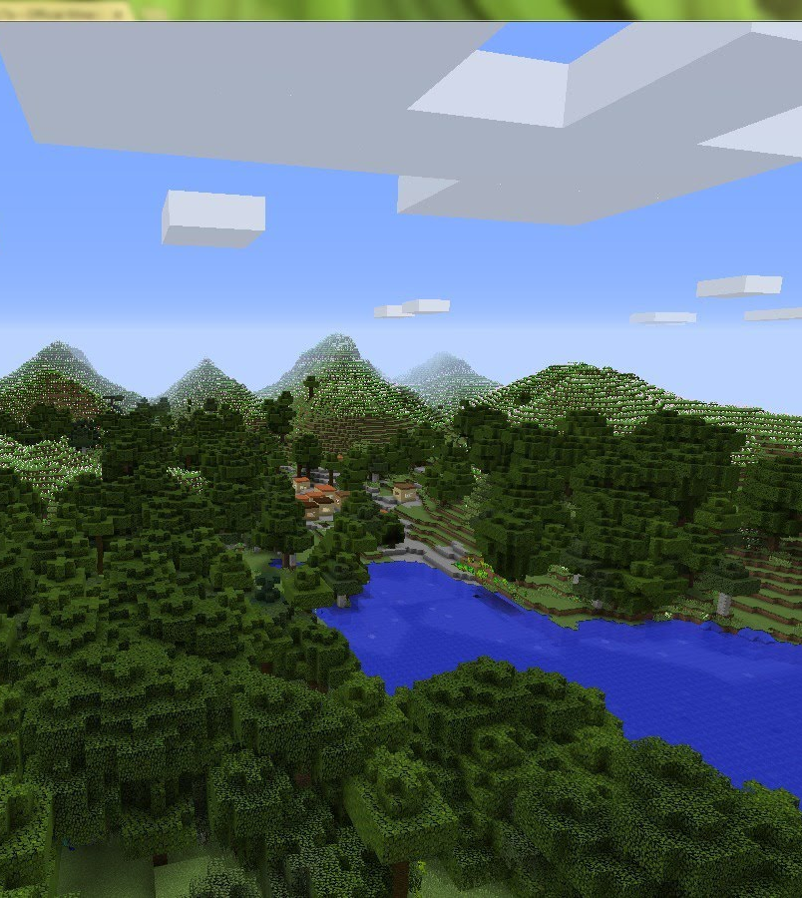
Why?
1) InsectAI have a deliverable around this topic
Publish open designs… codesign sprint with the maker community, such that the designs can be replicated by other makerspaces around the world
2) It is an opportunity to reach new audiences
3) It provides legacy for InsectAI
4) It is an opportunity to share knowledge and build collaborations

Slide 4
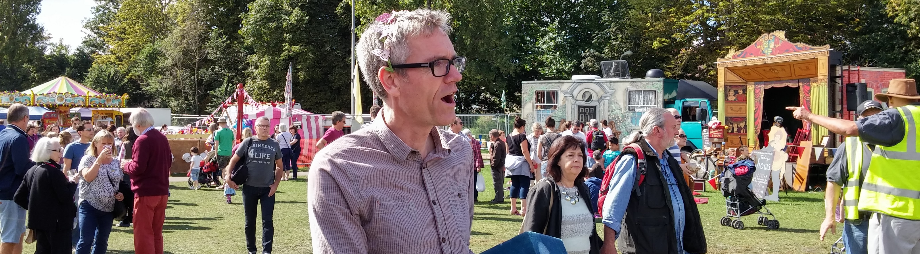
Mission
Develop an open, DIY, kit for building an automated insect trap, that will educate and inspire people with the world of insects

Slide 5
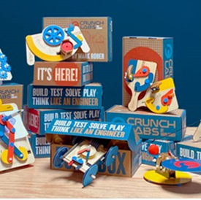
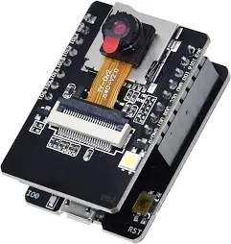
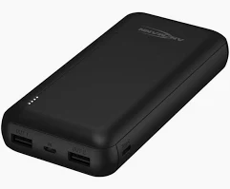

Objectives
A kit that children can build with supervision
Available at a allow cost – target under 50 Euros
Can be built within a classroom session – about one hour
Can be delivered in a small box
Comes with materials about AI and insects
Users are educated and inspired
Brings us together!
Provides a legacy for InsectAI

Slide 6
Today’s task
Brainstorming ideas that fit this scope
- Suitable for Children 8-12 years old
- Educational and inspirational
- Can be used in a classroom session of ~60 min
- Can be made at scale for <50 Euro (target)

Slide 7
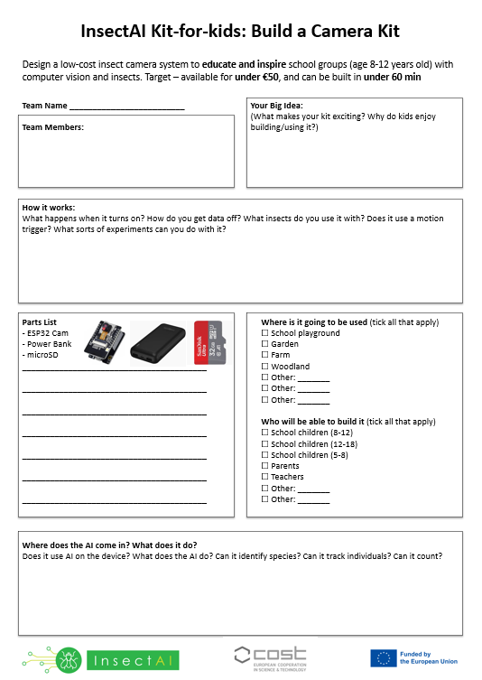
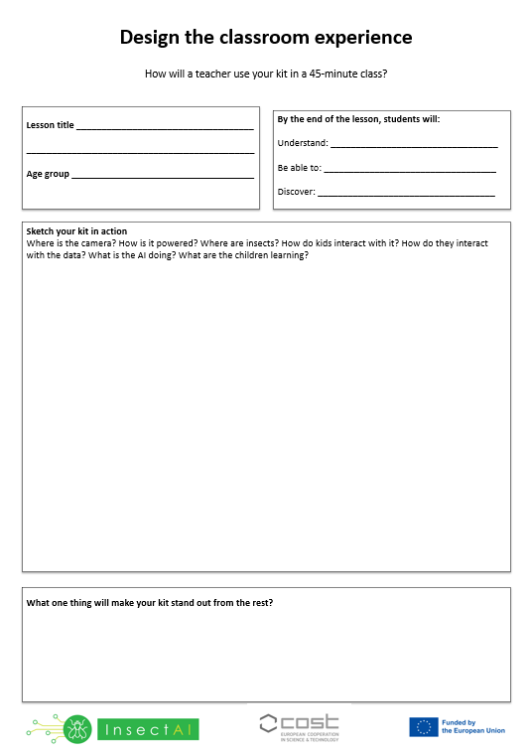
Sheets explainer
Be creative, anything goes
Work to your strengths
Write it down
Teams of 4-5 work best

Slide 8
Today’s task
Brainstorming ideas that fit this scope
- Suitable for Children 8-12 years old
- Educational and inspirational
- Can be used in a classroom session of ~60 min
- Can be made at scale for <50 Euro (target)

